Slide 1


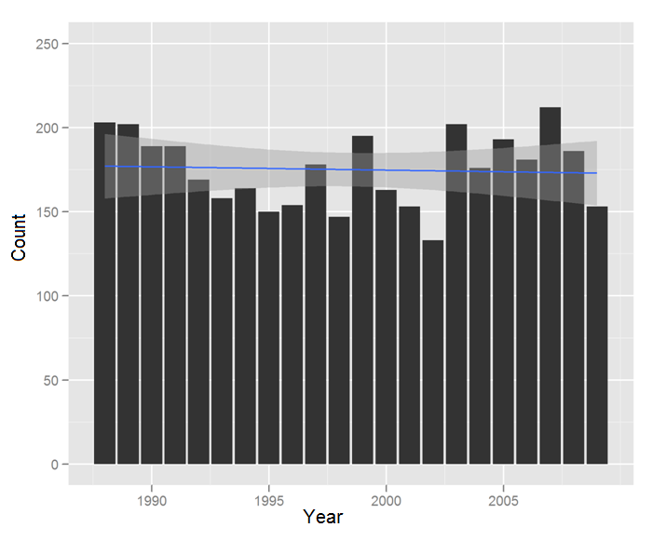
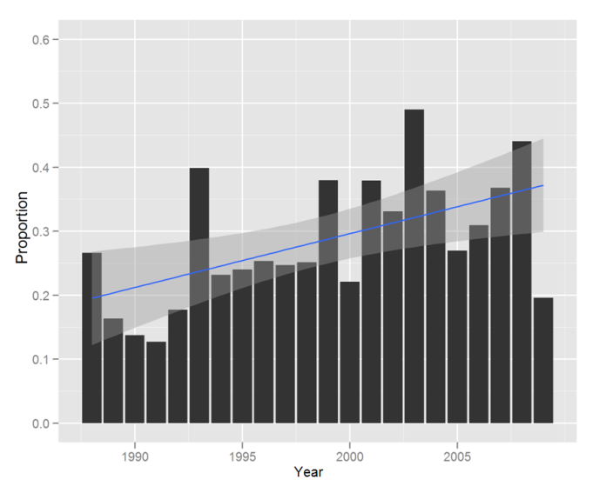
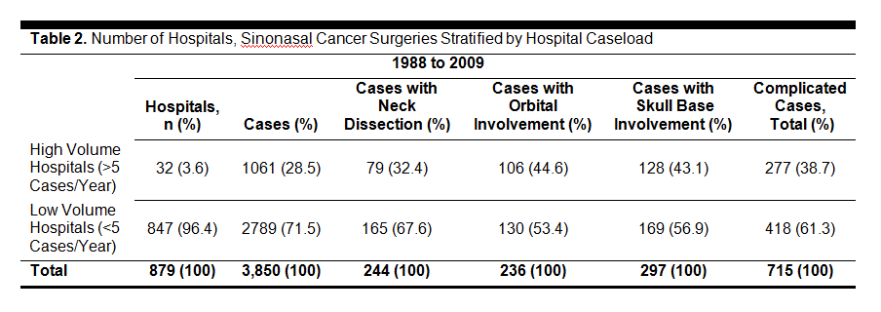


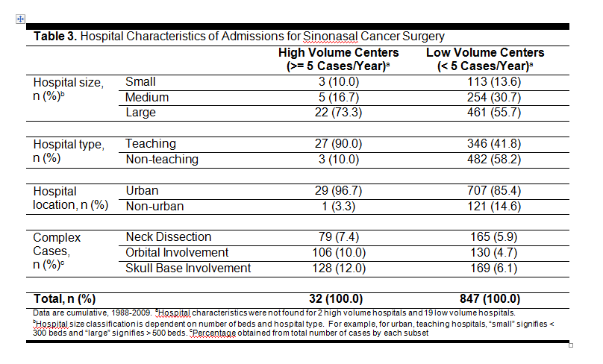
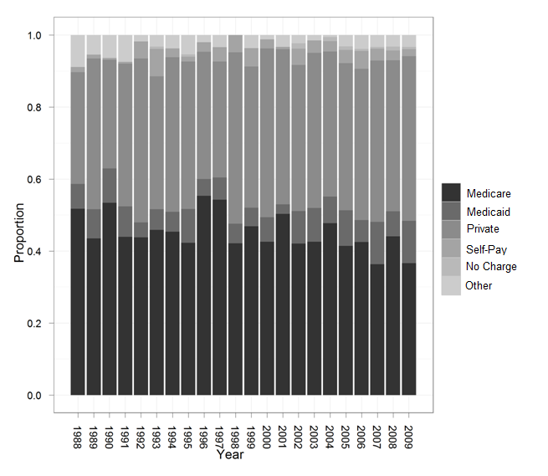
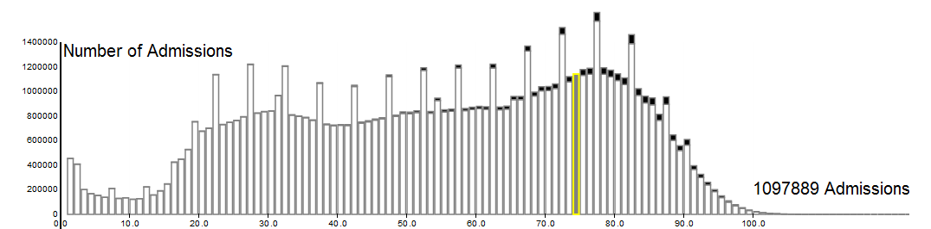

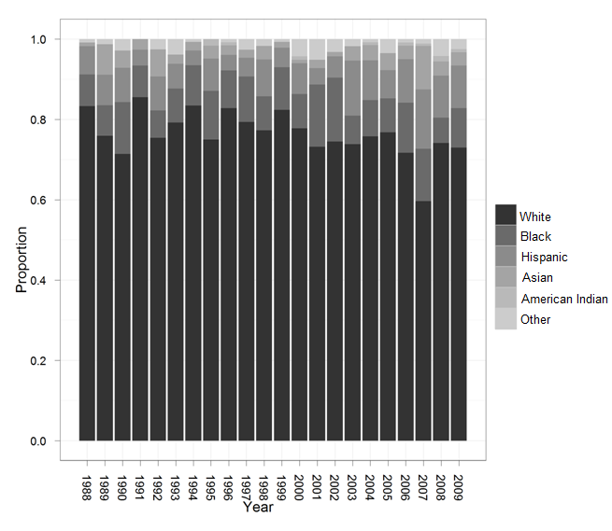
Nationwide Trends in Surgery for Sinonasal Malignancy and the Effect of Hospital Volume on Short-Term Outcomes
Nationwide Trends in Surgery for Sinonasal Malignancy and the Effect of Hospital Volume on Short-Term Outcomes
David Ouyang, B.S.¹, Ivan El-Sayed, M.D.², Sue S. Yom, M.D., Ph.D.¹² ¹Department of Radiation Oncology, University of California, San Francisco, ²Department of Otolaryngology-Head and Neck Surgery, University of California, San Francisco,
David Ouyang, B.S.¹, Ivan El-Sayed, M.D.², Sue S. Yom, M.D., Ph.D.¹² ¹Department of Radiation Oncology, University of California, San Francisco, ²Department of Otolaryngology-Head and Neck Surgery, University of California, San Francisco,
Background
Retrospective Cohort Analysis with the Nationwide Inpatient Sample
Conclusions
Sinonasal cancers account for only between 1-3% of head and neck cancers. A wide range of tumors can originate in the sinonasal cavities including squamous cell carcinoma, adenocarcinomas, and neuroendocrine carcinomas. Given the low incidence and heterogenous histology of sinonasal cancers, there are no randomized trials indicating the optimal management.
While surgery in combination with radiation plays a definitive role in the management of many sinonasal cancers, limited data exists regarding the patterns of surgical care as it is delivered across the United States. Sinonasal and skull base surgery is a specialized enterprise that benefits from the deployment of a multidisciplinary team, with high potential for immediate and severe life-threatening complications which may require urgent surgical intervention. There is little data documenting the context in which surgery for sinonasal cancer is performed, where high risk surgeries are performed, or whether there is any variation in outcomes among high- and low-volume surgical centers.
Population Characteristics
Hospital Characteristics
Sinonasal cancers are a highly heterogeneous collection of morbid neoplasms often initially treated with surgery and adjuvant radiotherapy. Initially, these cancers can be clinically silent or mimic benign disease such as sinusitis or upper respiratory infections, resulting in late detection when cancers are advanced, as evidenced by a relatively high proportion of locally advanced disease extension at presentation. Demographic analysis reveals that our findings are consistent with population-based data from other major Nationwide database analyses, showing a male-predominant patient population mostly between 50-70 years of age that has not significantly changed in incidence over the last twenty years. Our data did not show significant changes over time in patient race or insurance status.
In the Nationwide Inpatient Sample, high-volume centers are more likely to perform more extensive surgeries involving the skull base or orbit, and these centers also performed more neck dissections. Greater awareness and the ability to deploy advances in the surgical management of sinonasal cancer could explain the higher rates of referral over time to high-volume, more experienced centers. Previous studies have shown decreased morbidity, decreased mortality, and decreased lengths of stay at higher-volume centers for surgical management of a variety of head and neck cancers .
High-volume surgeons, more commonly found at high-volume centers, have also been found to have decreased perioperative complications, improved long term survival in cancer, and reduced hospital costs [14,15,16,17]. These effects have been especially seen in complicated cases [15]. In our sample, despite performing more extensive surgeries, high-volume centers had equal or lower rates of infection, neuropathy or visual impairment (despite more skull base and orbit surgery), and mortality. Particularly in cases with skull base involvement, it could be advantageous to have surgery at a high-volume center with an integrated approach including neurosurgical and advanced postoperative support. Alternatively, since this study lacks tumor staging data, it is also possible that equivalently advanced-stage tumors are being treated with less aggressive surgeries at low-volume centers.
Although there has been an increase in the number of complex sinonasal surgeries performed, there has been a decrease in perioperative mortality. Prior studies of skull base surgery have demonstrated an improved mortality over the past 40 years primarily due to decreased infection rates and improved reconstructive techniques. These techniques have allowed more extensive extirpative surgeries without an increase in mortality. The incidence of infectious complications has gone down over time, while there in has been an increase in the number of electrolyte abnormalities and cardiopulmonary complications. These trends are in keeping with the findings of our study, in which high-risk surgeries are performed with greater complexity of postoperative management but without concomitant increases in mortality.
Sinonasal Cancer
We identified 3850 cases of sinonasal surgery between 1988 and 2009 (Figure 1). Patients had a mean age of 61 years and stayed on average 6.8 days in the hospital. Consistent with previous accounts, we found a male predominance in the studied population, comprising 57.2% of all patients. The volume of sinonasal cancer surgery has not changed appreciably over the last twenty years, but a greater proportion of these surgeries are now being performed at higher-volume centers (Figure 1, R² = 0.268, p > 0.001).
We separated hospitals into centers that perform relatively higher numbers of sinonasal cancer surgery cases (greater than 5 cases per year) and centers that perform fewer sinonasal cancer surgery cases (less than 5 cases per year). Thirty-two hospitals that averaged more than 5 cases per year were identified and these hospitals accounted for 28% of all sinonasal surgery cases. These hospitals were more frequently represented in high-risk cases, accounting for 32.4% of all cases requiring neck dissection, 44.9% of cases with orbital involvement, and 45.7% of cases with skull base involvement, despite comprising only 3.6% of all hospitals that performed a sinonasal cancer surgery . At high-volume centers, 26.1% of cases were high-risk cases, compared to 15.0% of cases at low-volume centers. High-volume centers tended to be teaching hospitals (P > 0.001), and large, urban hospitals were also more represented.
Retrospective Cohort Analysis with the Nationwide Inpatient Sample
.
The Nationwide Inpatient Sample is a 20% stratified sample of inpatient admissions of US hospitals. Approximately 1000 of the 5000 hospitals in the United States were represented in stratified weighted sample representing 43 states in 2008. Data was extracted from non-delimited ASCII files using Python and R.
Short Term Complications
Our Research Question
Citations
1. Mendenhall WM, Amdur RJ, Morris CG, Kirwan J, Malyapa RS, Vaysberg M, et al. Carcinoma of the nasal cavity and paranasal sinuses. Laryngoscope. 2009 May;119(5):899–906.
2. Thorup C, Sebbesen L, Danø H, Leetmaa M, Andersen M, Buchwald C, et al. Carcinoma of the nasal cavity and paranasal sinuses in Denmark 1995-2004. Acta Oncol. 2010 Apr;49(3):389–94.
3. Hawkins RB, Wynstra JH, Pilepich MV, Fields JN. Carcinoma of the nasal cavity--results of primary and adjuvant radiotherapy. Int J Radiat Oncol Biol Phys. 1988 Nov;15(5):1129–33.
4. Robbins KT, Ferlito A, Silver CE, Takes RP, Strojan P, Snyderman CH, et al. Contemporary management of sinonasal cancer. Head Neck. 2011 Sep;33(9):1352–65.
5. Finlayson EVA, Goodney PP, Birkmeyer JD. Hospital volume and operative mortality in cancer surgery: a Nationwide study. Arch Surg. 2003 Jul;138(7):721–725; discussion 726.
6. Gourin CG, Forastiere AA, Sanguineti G, Marur S, Koch WM, Bristow RE. Impact of surgeon and hospital volume on short-term outcomes and cost of oropharyngeal cancer surgical care. Laryngoscope. 2011 Apr;121(4):746–52.
7. Cheung MC, Hamilton K, Sherman R, Byrne MM, Nguyen DM, Franceschi D, et al. Impact of teaching facility status and high-volume centers on outcomes for lung cancer resection: an examination of 13,469 surgical patients. Ann Surg Oncol. 2009 Jan;16(1):3–13.
8. Turner JH, Reh DD. Incidence and survival in patients with sinonasal cancer: a historical analysis of population-based data. Head Neck. 2012 Jun;34(6):877–85.
9. Allen MW, Schwartz DL, Rana V, Adapala P, Morrison WH, Hanna EY, et al. Long-term radiotherapy outcomes for nasal cavity and septal cancers. Int J Radiat Oncol Biol Phys. 2008 Jun 1;71(2):401–6.
10. Dulguerov P, Jacobsen MS, Allal AS, Lehmann W, Calcaterra T. Nasal and paranasal sinus carcinoma: are we making progress? A series of 220 patients and a systematic review. Cancer. 2001 Dec 15;92(12):3012–29.
11. Gourin CG, Frick KD. Nationwide trends in laryngeal cancer surgery and the effect of surgeon and hospital volume on short-term outcomes and cost of care. Laryngoscope. 2012 Jan;122(1):88–94.
12. Grau C, Jakobsen MH, Harbo G, Svane-Knudsen V, Wedervang K, Larsen SK, et al. Sino-nasal cancer in Denmark 1982-1991--a nationwide survey. Acta Oncol. 2001;40(1):19–23.
13. Fasunla AJ, Lasisi AO. Sinonasal malignancies: a 10-year review in a tertiary health institution. J Natl Med Assoc. 2007 Dec;99(12):1407–10.
14. Birkmeyer JD, Stukel TA, Siewers AE, Goodney PP, Wennberg DE, Lucas FL. Surgeon volume and operative mortality in the United States. N Engl J Med. 2003 Nov 27;349(22):2117–27.
15. Lee CH, Hur DG, Roh H-J, Rha K-S, Jin H-R, Rhee C-S, et al. Survival rates of sinonasal squamous cell carcinoma with the new AJCC staging system. Arch Otolaryngol Head Neck Surg. 2007 Feb;133(2):131–4.
16. Batsakis JG, Rice DH, Solomon AR. The pathology of head and neck tumors: squamous and mucous-gland carcinomas of the nasal cavity, paranasal sinuses, and larynx, part 6. Head Neck Surg. 1980 Aug;2(6):497–508.
We sought to examine contemporary patterns of sinonasal cancer surgery in the United States over a period spanning 1988 to 2009. In this study, through analysis of a Nationwide inpatient database, we investigated the short-term surgical outcomes of sinonasal cancer surgery patients and evaluated the impact of hospital volume on these outcomes.

